Slide 1

Structural Integrity Assessment System
DEVELOPMENT PROJECT
Group 24
Milind Kurma
Luke Kim
Sharmisha Parvathaneni
Punit Malpani
This Photo by Unknown Author is licensed under CC BY-NC-ND

Slide 2
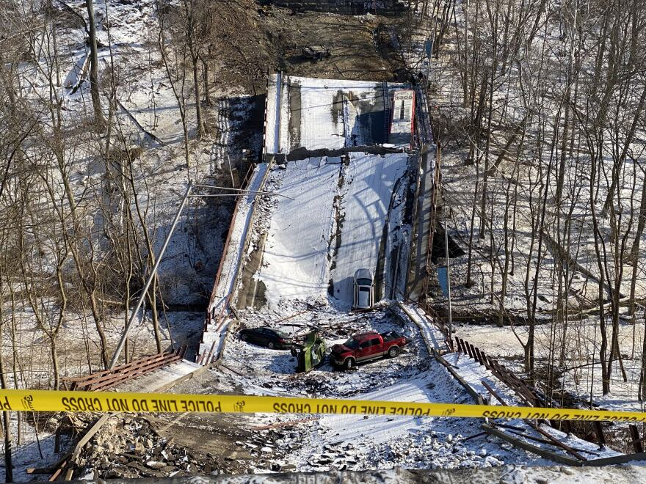
Motivation & Purpose
On January 28, 2022, the Fern Hollow Bridge collapsed
- 13 people were injured
- Multiple vehicles were flipped over
With advanced automations blooming in every field, we need technological measures to prevent such accidents
So, as a team we have come up with an idea of SIAS: to prevent such catastrophic events and plan in advance to ensure safety
Figure 1: Fern Hollow Bridge, Pittsburgh, Pennsylvania

Slide 3
Structural Integrity Assessment System
Project Overview
What is Structural Integrity Assessment System?
It is a system that proposes observation and analysis of the robustness and strength of a civil structure
It will monitor changes in mechanical and geometric properties of the structure using sensor technologies
Based on the sensor readings, appropriate analysis will make assessments & suggestion

Slide 4
Structural Integrity Assessment System
Working
The Structural integrity of any construction, say, a bridge, a building or a dam, can be estimated using the following factors:
Tilt
Crack formations
Sinking abutments
Strain and Load shifts
Monitoring of existing cracks
Degradation of load bearings
Notes:
Tilt- horizontal displacement between the top and bottom of a structure
Abutments- a structure built to support the lateral pressure of an arch or span, e.g. at the ends of a bridge.
Changes in load changes strain
A load bearing structure is a structure in which the weight is transferred from the roof to the walls which transfers to the foundation.

Slide 5
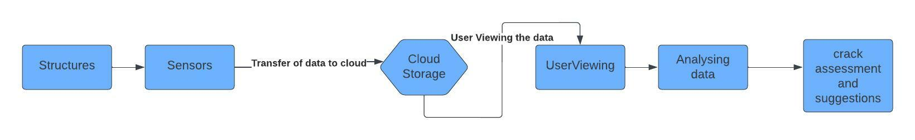
Structural Integrity Assessment System
Working
Our project proposes use of multiple and multitudinous sensors connected to a cloud platform to transmit data to a local station
Data from sensors is monitored at all times
Figure 2: Flow Diagram

Slide 6
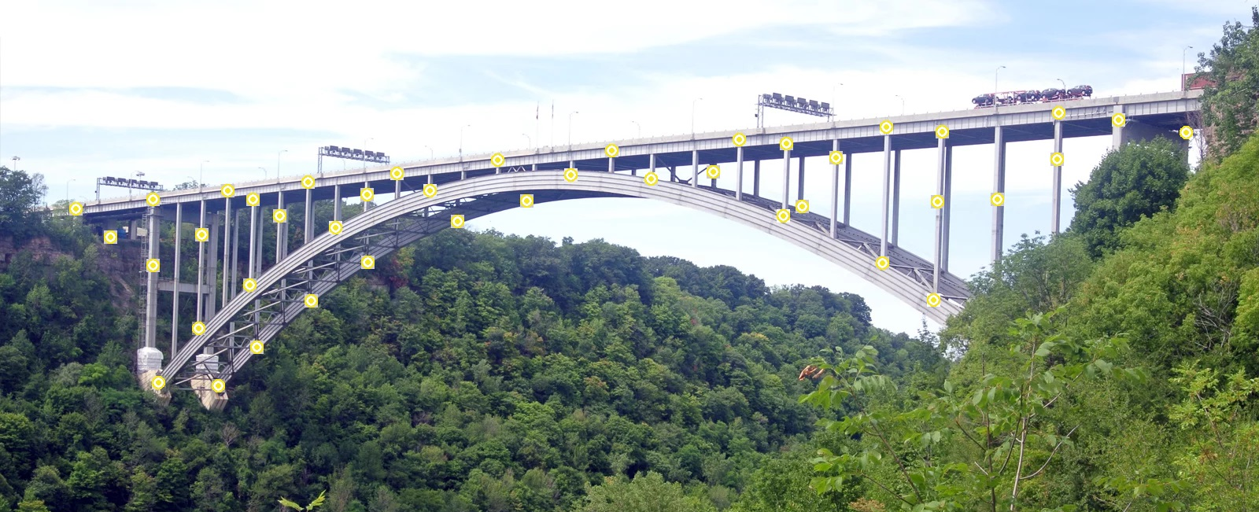
Structural Integrity Assessment System
Working

Slide 7
Structural Integrity Assessment System
But, What are these sensors?
What is their purpose?
What information is transmitted?

Slide 8
Structural Integrity Assessment System
Sensor Technology:
Sensor used to deploy the final result have multiple capabilities, including:
Measurement of angles on three axes
Temperature
Frequency and amplitude of the vibrations
Stress
The cloud platform will give detailed information about each sensor and view about the sensors placed

Slide 9
Structural Integrity Assessment System
Stakeholders
World leading construction companies like Careys, Morgan Sindall
Small construction company owners or private builders
Construction agencies working on structures with high risk of natural disasters

Slide 10
THANK YOU!

